Slide 1

Predicting Chemical Species
Samuel Scovronski
Dec. 7th, 2021

Slide 2
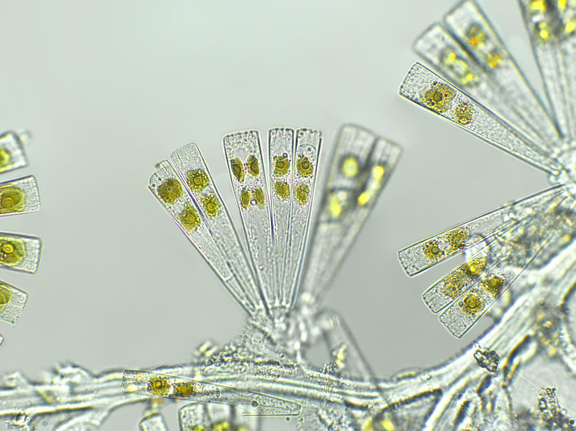
Problem Statement
Many industries use chemical reactions in the manufacturing of their products
Selection and control of chemical processes still require manual intervention
The incorrect chemical and concentration could result in inferior or potentially harmful products, opening the companies to expensive lawsuits
Can we predict which chemical is being processed using a chemical sensor array?
How many sensors are needed to predict the chemical species?
Notes:
Incorrect chemicals or concentrations could result in incorrect chemistry of the drugs produced by pharmaceutical companies leading to huge lawsuits and legal liabilities
Incorrect chemical concentrations in semiconductor processing would result in inferior microchips causing the company to sell lower grade chips.

Slide 3
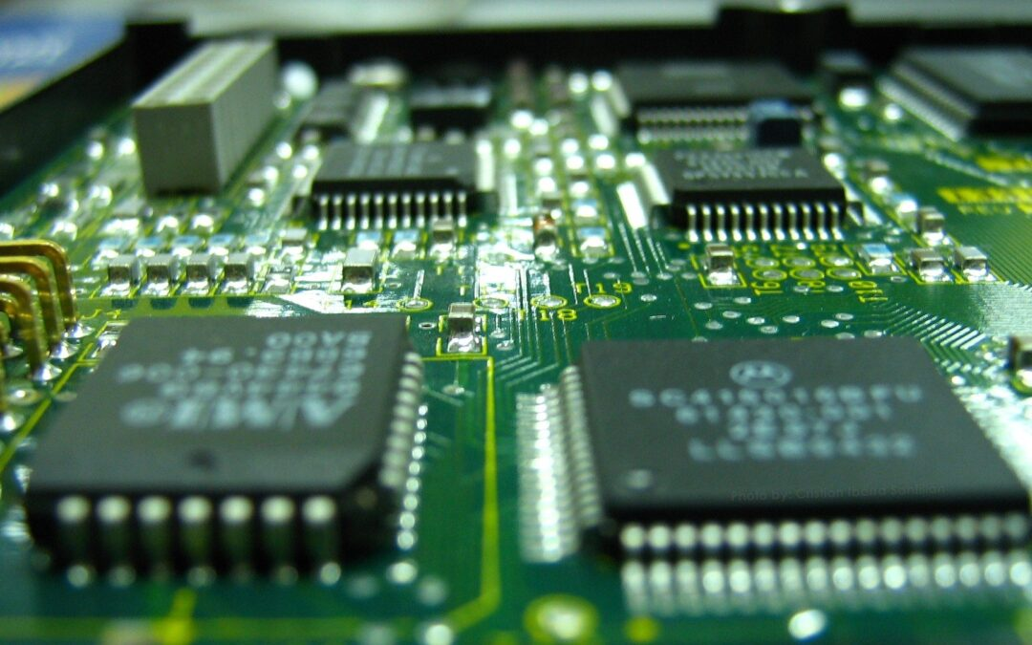




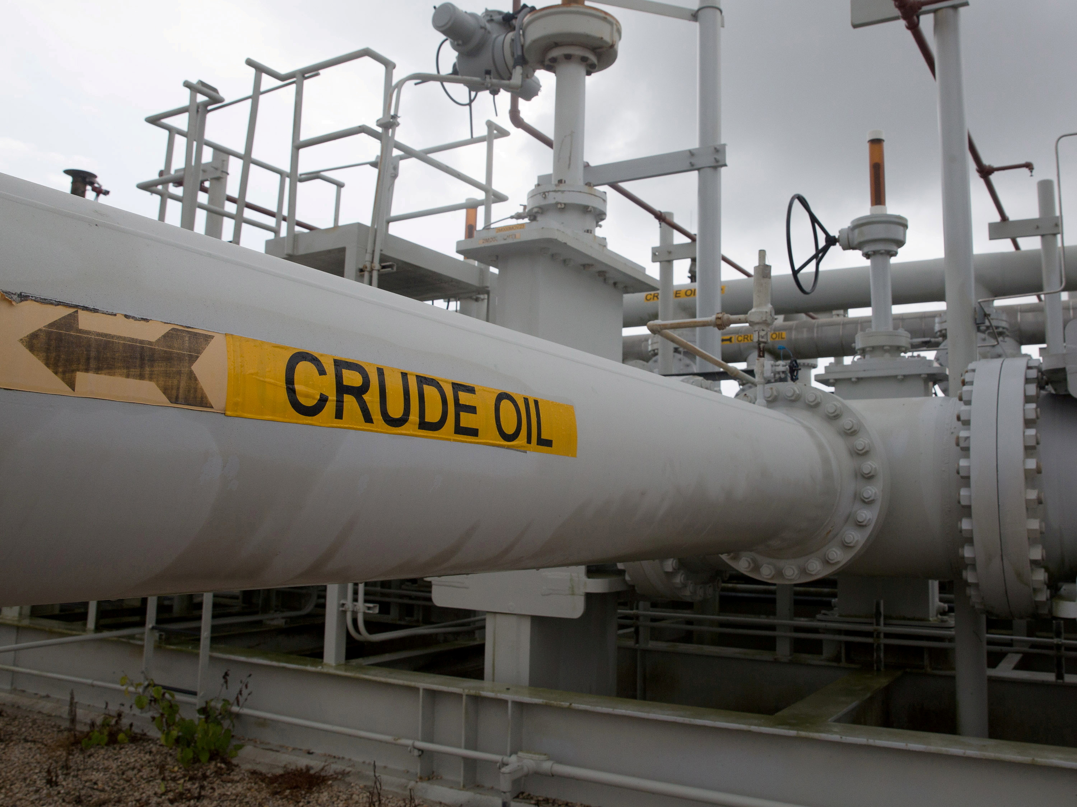
Why it is important?
Companies that use chemical processes
Their products

Slide 4

Data source
All data was provided by the BioCircuits Institute at UC – San Diego through UCI Machine Learning Repository
http://archive.ics.uci.edu/ml/datasets/Gas+Sensor+Array+Drift+Dataset+at+Different+Concentrations
Data provided was created using a sensor array comprising of 16 chemical sensors and their response to 6 chemical species at varying concentrations.
(Ammonia, acetaldehyde, Acetone, Ethylene, Ethanol, Toluene)
8 engineered features were taken from the raw electrical signal of each sensor resulting in a total of 128 predictor variables, and two target variables (chemical species & concentration)

Slide 5
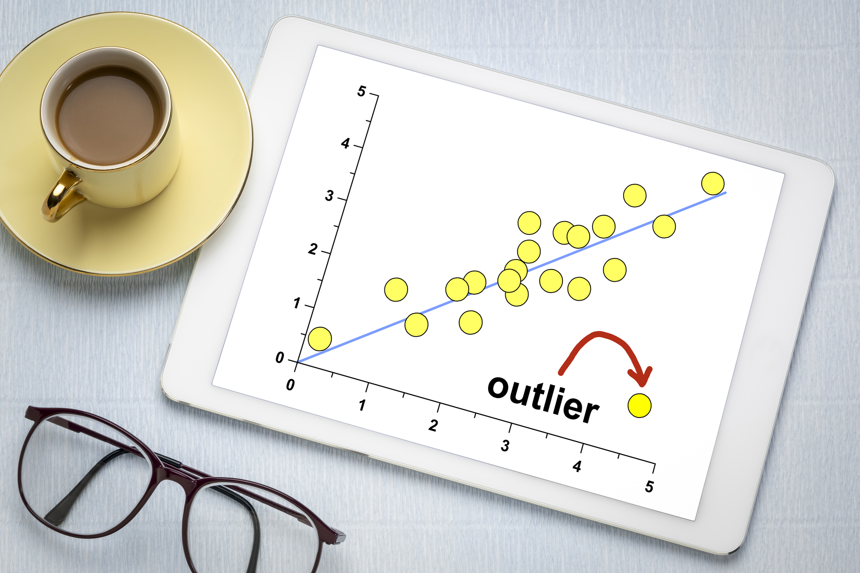
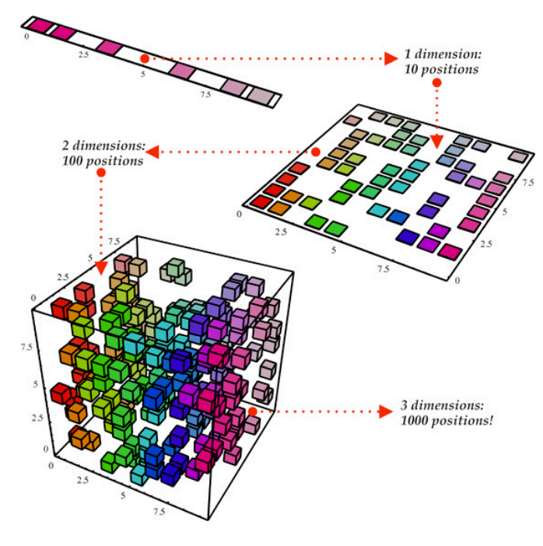
Data Exploration
Outliers
Dimensionality Reduction

Slide 6
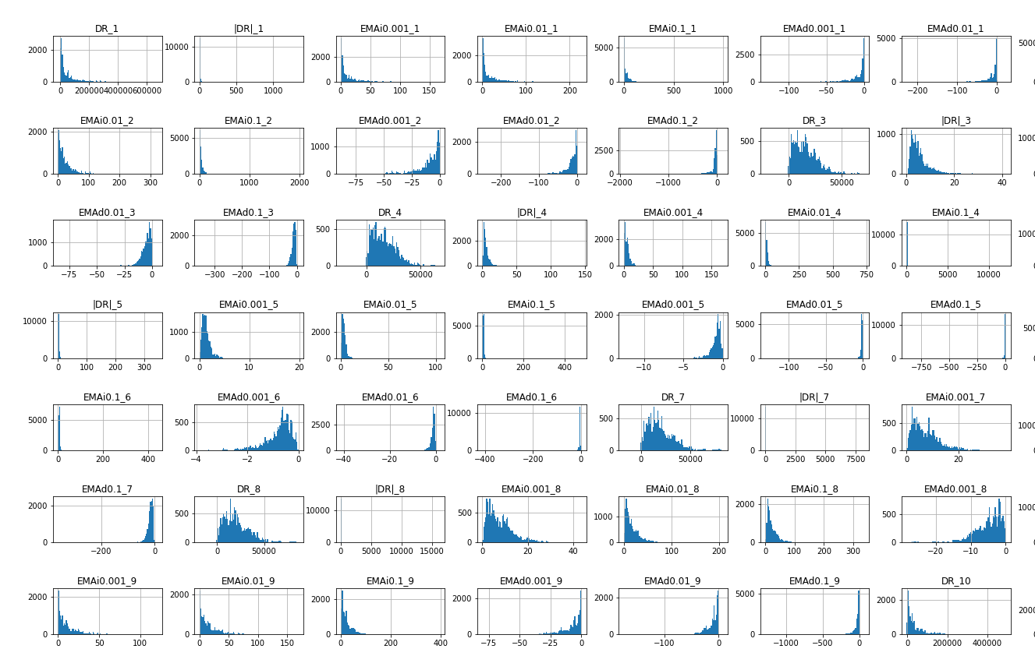
Outliers
Definition: values more than 1.5 times the IQR outside of the IQR (25 percentile to 75 percentile range)
35.3% of experimental runs had at least one feature that had an outlying value
Visually represented by the amount of white space in the distributions
Numerically represented with high Kurtosis values
Performed hypothesis tests to determine if a target variable was causing outliers
Selected predictor features distributions

Slide 7
Outlier Hypothesis Tests
Note: Hypothesis testing was performed using 10,000 bootstrap samples
Null Hypothesis | P-value | Results
Outlier values are not associated with specific chemical species | N=6 -> p-value < 0.008 | Acetone (chemical 5) is associated with outlying values
Outlier values are not associated with specific chemical concentrations | N=59 -> p-value < 0.00085 | Concentrations > 350 ppm are associated with outlying values
Outlier values are not associated with specific test batches | N=10 -> p-value < 0.005 | Experimental batches 1, 4 and 10 are associated with outlying values

Slide 8
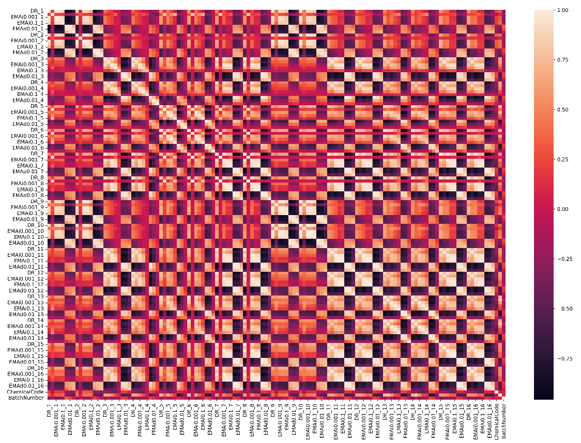
Dimensionality Reduction
Correlation Heatmap of Variables
Many of the predictor features were highly correlated with other features
High correlation is bad if we plan on making evaluating a linear regression model since it can lead to high variance in the weights
The feature set can be reduced by choosing one of the correlated features or doing a principal component analysis

Slide 9
Data Preparation
Data Splitting
Feature Selection
Data was split into three groups: train, test, and future
Train and test groups were randomly chosen samples from the first five experimental batches (3,600 rows)
The size of train and test was purposefully varied to determine the response on model accuracy
Future group was used to evaluate on-going model performance
Various sensor combination feature sets are needed to determine the required number of sensors
There are 65,519 potential sensor combinations
A basic decision tree model was used to determine which sensors were the most impactful
Combinations of these sensors were used in the evaluation

Slide 10
Baseline Model Performance
Chemical 1
Chemical 6
Chemical 4
Chemical Species Predictions
need a multi-class prediction model to determine the chemical species
Two simple models were used as a baseline to compare against complex models
Random Selection
Most Frequent
Theoretical Accuracy = 16.7%
Actual Model Accuracy = 15%
Theoretical Accuracy = 28%
Actual Model Accuracy = 28%

Slide 11
Machine Learning Model Selection
Five model algorithms were evaluated
Linear SVC, k Nearest Neighbors, Random Forest, Gaussian Naïve Bayes, Decision Tree
Evaluated using the same training and test data
Model Type | Fit Time | Score Time | Accuracy
Decision Tree | 0.2933 | 0.0017 | 0.966
Random Forest | 1.6627 | 0.0232 | 0.989
kNN | 0.0848 | 0.1237 | 0.978
Linear SVC | 0.6342 | 0.0055 | 0.983
Gaussian Naïve Bayes | 0.0093 | 0.0032 | 0.803
Conclusion: Random Forest performs the best

Slide 12
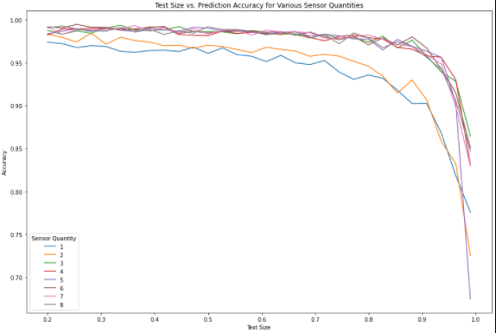
Model Tradeoffs
Tradeoff Setup
30 test sizes between 0.2 and 0.99
8 sensor combinations with each combination having an additional sensor
Goal is to have >99% accuracy
Tradeoff Conclusions
Need at least 3 sensors
Sharp drop off in model accuracy when less than 800 rows are used in the training set

Slide 13
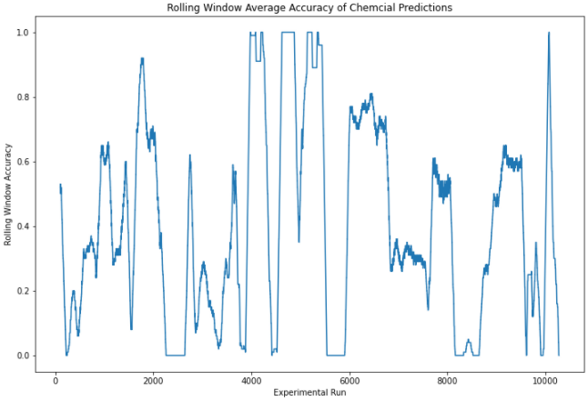
Poor Long-Term Performance
Based on previous results, a model using 5 sensors and a test size of 50% was created
After batch 5 the model accuracy dramatically decreases
Unsure if this is due to over-fitting or a change in the test system

Slide 14

Future Work
Improve long-term performance
Did the system change or is it a model issue?
Predict Chemical Concentration

